Slide 1
BIIC – Debit Issuing & ATM Acquiring Projects
Soft Handing Over
ICPS Project Office
Prepared by: Yannick Marion

Slide 2
Project Overview
Project Architecture
Connectivity Setup
Debit Card Solution
ATM Acquiring
Accounting - Customisations
Batches
Reports
Issues & Resolution
Metrics/KPI
Ihelp Tickets
Project Status
Upcoming Projects / Change Requests
Contact Details
Agenda

Slide 3
Project Overview
Banque Internationale pour l'Industrie et le Commerce (BIIC) is a French-speaking bank in Benin.
BIIC has approached ICPS to help enhance its product offering to its customers by implementing specific projects aligned with the bank’s strategy, to provide a solution for the following services:
VISA Debit Issuing (Pre-personalized instant issuance)
Interoperability of VISA Debit Card over the GIM Network (Issuing).
ATM Driving & Acquiring of ON-US Cards & GIM Branded Cards.
Project Scope
The implementation and parametrization of a PCI compliant debit issuing platform for BIIC as per the business requirements of the bank.
Set up of VISA BASE 1 Interface for BIIC Debit Issuing Authorizations.
Set up of NDC Interface & ATM Acquiring Parameters (Profile/Fit/etc.).
Set up of GIM Interface for BIIC Debit Issuing Authorizations (Within UEMOA region).
Set up of BIIC on Netcetera' s Platform for 3D Secure functionality.
Set up of PIN Selection on Famocco Solution (No MPOS).
Set up of PowerCard Fraud Module.
Set up of RAW JSON File Extractions Process.
Implementation of key block mandate.
System Integration Testing.
Certification – White Plastic Certification (CPV), Artwork validation, Offline Certification with VISA , Online Certification with VISA, Certification with GIM.
Training of BIIC staff and User Acceptance Testing.
Go-Live and Pilot Phase.

Slide 4



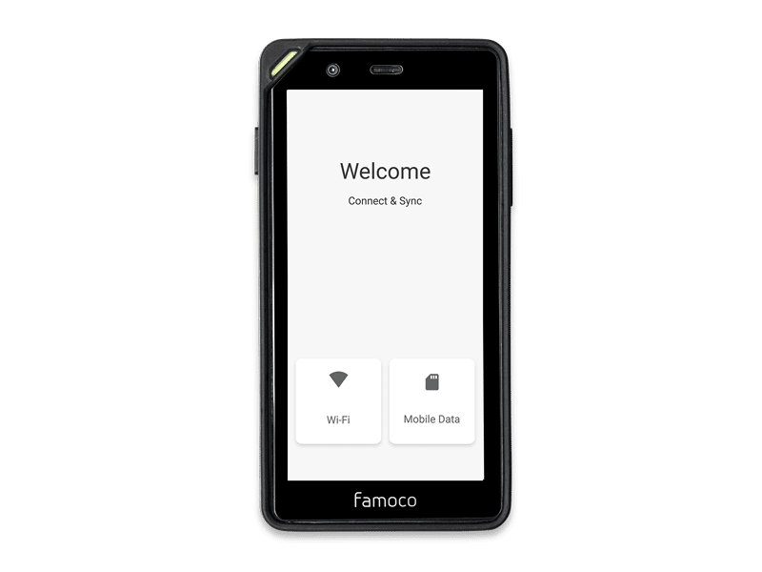







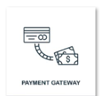






Project Architecture
KEY
SBIN
ACS
Famocco
NETCETERA
ACS
VISA
SMTP/ClickSend
SBIN
BIIC SMTP
Famocco Device
GIM
NDC
OTP by Mail
ACS WS End Point (172.17.100.95)
ICPS SMTP Relay
NCR ATM
192.168.137.99
RAW JSON Files
OTP by SMS
Port: 7025
NDC_SRV
Bulk Enrolment
GRG ATM
PowerCARD
GIM SID
Mobile Gateway
BASE1
172.17.100.55
SID - HOST
172.17.100.56
JPOS
SOPRA - AMPLITUDE

Slide 5
Project Architecture
POWERCARD
BIIC projects have been implemented on PowerCard v3.2.
Amplitude - Sopra
The Core Banking System of BIIC is Amplitude
All debit transactions are generated in an accounting file to be uploaded on Amplitude.
BIIC does funds holding at Core Banking level at authorization level. Using the accounting file generated by ICPS, BIIC does transaction matching and impacts the cardholders’ accounts.
GIM UEMOA
GIM UEMOA is an interbank, non-profit organization that brings together a series of banks spread over Senegal, Guinea-Bissau, Mali, Burkina Faso, Niger, Cote d'Ivore, Togo, and Benin.
ICPS connects to GIM UEMOA via a SID interface.
ATM
BIIC is an acquirer of NCR and GRG ATMs.
The ATMs are driven by PowerCard.
The ATMs connect to PowerCard via a single NDC_SRV interface.

Slide 6
Project Architecture
PIN SELECTION ON FAMOCCO
BIIC will use Famoco device for PIN selection for Online PIN ONLY. No MPOS are available.
POWERCARD FRAUD MODULE
BIIC has implemented real time / near real time rules.
The rules are currently disabled in production as requested by the bank.
NETCETERA
Netcetera provides the 3D Secure functionality to BIIC. Enrolment is done via batch (OAS XML File).
BIIC has not opted for Bank Enrolment Portal.
XH Smart
XH Smart is the card personalization bureau of BIIC.
ICPS will be responsible to generate the card production file (V2 Format & PGP encrypted).
The files are transferred to BIIC SFTP and BIIC share the card production files to XH.
SBIN
SBIN is a third party provider that provides a data storage solution to BIIC for maintaining / loading RAW JSON files shared from ICPS.
RAW JSON Files are generated using ICPS BI tool (executed via JENKINS – similar process as other banks).

Slide 7
Project Architecture
TRANSACTION FLOWS
On-Us Card Local ATM (Debit) : Local ATM > GIM UEMOA > PWC V3.2> Amplitude
On-Us Card Local POS (Debit) : Local POS > GIM UEMOA > PWC V3.2> Amplitude
On-Us Card Foreign ATM (Debit) : Foreign ATM > BASE 1 > JPOS SWITCH > PWC V3.2> Amplitude
On-Us Card Foreign POS (Debit) : Foreign POS > BASE 1 > JPOS SWITCH > PWC V3.2> Amplitude
GIM Card on BIIC ATM : BIIC ATM > GIM UEMOA

Slide 8
Connectivity Setup
ICPS
VPN
BIIC
ICPS
VPN
GIM (Main)
VPN
GIM (DR)
ICPS
VPN
SBIN

Slide 9
Debit Card Solution
Debit Card Overview
Issuing Debit Services
Card Perso Bureau : XH Smart
Visa contactless chip card
CARD
BIN: 40332700 (8-digit BIN)
Currency: XOF (West African Franc)
BIN/Currency
Classic: VDC
Gold: VDG
Platinum: VDP
Validity: 36 months
Product
Cash withdrawal
Balance Inquiry
Cash Advance
Purchase
E-Commerce (3D Secure)
Reversal
Quasi Cash

Slide 10
ATM Acquiring
TERMINAL_ATM_NUMBER ATM_ACRONYM
00000084 CADJEHOUN NCR 1
00000085 MARO MILITAIRE NCR 1
00000086 JERICHO NCR 1
00000087 KOKOYE NCR 1
00000088 DAB PARAKOU GRG 1
00000089 DAB GOHO GRG 1
00000090 DAB GLO DJIGBE GRG 1
00000091 DAB ETOILE GRG 1
00000092 DAB MALANVILLE GRG 1
00000093 DAB KANDI GRG 1
00000094 DAB BEMBEREKE GRG 1
00000095 SAVE NCR 1
00000097 GBODJE PORTO NOVO
00000098 BENIN PETRO OUIDAH
00000099 BENIN PETRO HEVIE
00000100 CAMP MILITAIRE ALLADA
00000101 ORYX EREVAN
00000102 BENIN PETRO AGLA
00000103 BENIN PETRO VEDOKO
Deployed ATMs: 19
Remaining ATMs ~ 20
ATM Deployment Process:
1. Define Keys in HSM_KEY_MEMBER.
2. Create Terminal ATM on PowerCard Screen.
3. Define merchant at database level:
select * from mer_acquiring_site;
select * from mer_activity ;
select * from merchant;
select * from mer_acceptor_point ;
select * from mer_account;
select * from accounts_link;

Slide 11
Accounting - Customizations
/*YM22112022 - Requirements for BIIC VISA Debit Issuing Project */
IF p_transaction_hist_rec.acquirer_bank_code = '000001'
THEN
v_accounting_entries_record.REFERENCE_OF_DOCUMENT := p_transaction_hist_rec.merchant_number;
ELSE
IF p_transaction_hist_rec.transaction_code = '01' AND substr(p_transaction_hist_rec.pos_data,6,1)='0' -- E-Commerce
THEN
v_accounting_entries_record.reference_of_document := 'PMT@WEB/' || p_transaction_hist_rec.reference_number || '/' || p_transaction_hist_rec.processing_date || '/' || '"TERM" ' || p_transaction_hist_rec.merchant_acronym || '/' || '"NUM_CARD" ' || p_transaction_hist_rec.card_number;
ELSIF p_transaction_hist_rec.transaction_code = '01'
THEN
v_accounting_entries_record.reference_of_document := 'PMT@TPE/' || p_transaction_hist_rec.reference_number || '/' || p_transaction_hist_rec.processing_date || '/' || '"TERM" ' || p_transaction_hist_rec.merchant_acronym || '/' || '"NUM_CARD" ' || p_transaction_hist_rec.card_number;
ELSIF p_transaction_hist_rec.transaction_code IN ('B2','B3','B4','05','09') --Cash Advance Fees, Purchase Fees, Quasicash Fees, Quasicash, Credit Voucher
THEN
v_accounting_entries_record.reference_of_document := 'PMT@WEB/' || p_transaction_hist_rec.reference_number || '/' || p_transaction_hist_rec.processing_date || '/' || '"TERM" ' || p_transaction_hist_rec.merchant_acronym || '/' || '"NUM_CARD" ' || p_transaction_hist_rec.card_number;
ELSIF p_transaction_hist_rec.transaction_code = '03' --Cash Advance
THEN
v_accounting_entries_record.reference_of_document := 'CSH@ADV/' || p_transaction_hist_rec.reference_number || '/' || p_transaction_hist_rec.processing_date || '/' || '"TERM" ' || p_transaction_hist_rec.merchant_acronym || '/' || '"NUM_CARD" ' || p_transaction_hist_rec.card_number;
ELSIF p_transaction_hist_rec.transaction_code IN ('04','B5') --Cash withdrawal & Cash withdrawal fees
THEN
v_accounting_entries_record.reference_of_document := 'RET DAB/' || p_transaction_hist_rec.reference_number || '/' || p_transaction_hist_rec.processing_date || '/' || '"TERM" ' || p_transaction_hist_rec.merchant_acronym || '/' || '"NUM_CARD" ' || p_transaction_hist_rec.card_number;
ELSIF p_transaction_hist_rec.transaction_code IN ('05') --QUASI CASH
THEN
v_accounting_entries_record.reference_of_document := 'PMT@WEB/' || p_transaction_hist_rec.reference_number || '/' || p_transaction_hist_rec.processing_date || '/' || '"TERM" ' || p_transaction_hist_rec.merchant_acronym || '/' || '"NUM_CARD" ' || p_transaction_hist_rec.card_number;
ELSIF p_transaction_hist_rec.transaction_code IN ('09') --CREDIT VOUCHER
THEN
v_accounting_entries_record.reference_of_document := 'PMT@WEB/' || p_transaction_hist_rec.reference_number || '/' || p_transaction_hist_rec.processing_date || '/' || '"TERM" ' || p_transaction_hist_rec.merchant_acronym || '/' || '"NUM_CARD" ' || p_transaction_hist_rec.card_number;
ELSIF p_transaction_hist_rec.transaction_code = 'B1' --Balance Inquiry Fees
THEN
v_accounting_entries_record.reference_of_document := 'CSL@SLD/' || p_transaction_hist_rec.reference_number || '/' || p_transaction_hist_rec.processing_date || '/' || '"TERM" ' || p_transaction_hist_rec.merchant_acronym || '/' || '"NUM_CARD" ' || p_transaction_hist_rec.card_number;
ELSE
v_accounting_entries_record.reference_of_document := v_acc_details_param_record.reference_of_document;
END IF;
END IF;
BEGIN
SELECT * INTO V_CARD_RECORD
FROM CARD c
WHERE C.CARD_NUMBER = p_transaction_hist_rec.CARD_NUMBER;
v_accounting_entries_record.reference_of_document := v_accounting_entries_record.reference_of_document || '/' || V_CARD_RECORD.branch_code;
EXCEPTION WHEN NO_DATA_FOUND
THEN
NULL;
END;
/*YM22112022 - Requirements for BIIC VISA Debit Issuing Project */
PCRD_ACC_TRANSACTION_HIST.PROCESS_ACCOUNTING_DETAILS

Slide 12
Accounting - Customizations
/*YM11042023 - Start - Development for requirement of BIIC - Add Microfilm Ref Number for card fees*/
-- v_accounting_entries_record.reference_of_document := v_acc_details_param_record.reference_of_document;
IF p_transaction_hist_card_rec.reversal_flag='N'
THEN
v_accounting_entries_record.reference_of_document := 'FRS@CAR/' || p_transaction_hist_card_rec.microfilm_ref_number|| p_transaction_hist_card_rec.processing_date;
ELSE
v_accounting_entries_record.reference_of_document := 'ANN@CAR/' || p_transaction_hist_card_rec.microfilm_ref_number|| p_transaction_hist_card_rec.processing_date;
/*GB17042023 - End - Development for requirement of BIIC - Add reversal for card fees*/
END IF;
/*YM11042023 - End - Development for requirement of BIIC - Add Microfilm Ref Number for card fees*/
PCRD_ACC_TRANSACTION_HIST_CARD.PROCESS_ACCOUNTING_DETAILS

Slide 13
Batches
Monthly Batches
Daily Batches
Cardholder Monthly Batch
Statistics Batch
Monthly Financial Batch
Update Business Date BO
Transaction Archive
ATM Cutoff Batch
Load Pre-Approved Card File
Nameless Card Creation
Cardholder Daily Batch
Card Production
Load VISA Incoming
Load GIM Incoming
Load LIS IN BIN File
Authorization Batch
Transaction Control V3
Pre-Clearing
Accounting Batch
Generate Accounting File
Generate GIM Outgoing
Generate OAS XML File
Purge

Slide 14
Reports
Daily Reports
Monthly Reports
atm_01_atm_financial_transaction
vis_12_visa_rejected
vis_11_visa_incoming_ret_req
vis_10_visa_incoming_chargeback
vis_09_visa_incoming_trx_fees
vis_07_visa_returned_items
vis_06_visa_incoming_financial
vis_05_incoming_misc_fees
rsk_05_cards_blocked_over_period
aut_01_authorization_log
aut_04_unmatched_auth_log
car_01_new_customer
car_02_client_update
car_03_card_update
car_04_card_maintenance
car_07_card_renewal_forecast
car_08_card_fees
car_11_non_renewed_cards
car_12_overall_issuing_fees
car_19_customer_maintenance
car_20_orphan_acc_client_cards
car_22_card_renewal
chr_03_incoming_chargeback
chr_04_incom_retrieval_request
com_01_user_profile
com_02_pending_adminitrator_actions
com_03_password_reset_report
com_04_invalid_passwords
com_05_audit_trail_report
com_06_failed_connection_attempts
com_08_on_administrator_report
rsk_01_card_blocked
atm_09_availability_report
atm_10_atm_status
atm_13_atm_suspect_transactions
sta_02_europe_debit_qtr
sta_16_visa_montly_debit
Weekly Reports
atm_06_list_of_captured_cards
atm_07_withdrawal_transactions
atm_08_atm_events
atm_11_atm_financial_statistics

Slide 15
Issues and Resolutions
Issues with wrong data in pre-approved card file causing batch to crash
Escalated to BIIC and BIIC is now ensuring that correct data is sent in the file.
OFFLINE PIN not synchronized after PIN change on ATM / PIN Selection on Famocco (Issuer script not sent).
Issue was in NDC , BASE 1, GIM & LIB_TRN binaries.
Fix tested and implemented in production.
Pilot Phase is in progress.
Fast-Cash not working on GRG ATMs for GIM Cards.
Fix in progress with delivery team.

Slide 16
Metrics/KPI
HUGE TABLES
Row Labels | Sum of MB
VISA_ARDEF | 59
STG_CARD_STOP_LIST_HIST | 48
STG_NEW_CLIENT_CARD_HIST | 48
STG_NEW_CLIENT_HIST | 48
STG_NEW_CLIENT_ACCOUNT_HIST | 48
STG_CARD_RENEWAL_FORECAST_HIST | 48
STG_CARD_MAINTENANCE_TABLE_HT | 48
AUTHO_ACTIVITY_HST | 40
PCARD_TRACES | 38
BUFFER_ARDEF | 35
CR_TERM | 32
CARD | 32
CLIENT_ADDENDUM | 32
CLIENT | 32
PCARD_ERRORS | 28
STG_VISA_INCOM_FINANCIAL_HIST | 24
TRANSACTION_HIST | 24
Grand Total | 664
TRACES LOGGED
Row Labels | Sum of CNT
STATUT : P_STATUT =S V_STATUT = P | 555
STATUT : S | 185
ORACLE ERROR <ORA-: at "POWEROMM.PCRD_GET_PAR | 150
ERROR RETURNED BY PCRD_CALL_EXTERNAL_TASK.CHECK_AN | 45
ERROR BATCH ALREADY STARTED : P | 45
PASSED TRANSACTIONS NBR --> | 35
REJECTED TRANSACTIONS NBR --> | 35
REJECTED TRANSACTIONS AMOUNT --> | 35
PROCESSED TRANSACTIONS NBR --> | 35
PROCESSED TRANSACTIONS AMOUNT --> | 34
PASSED TRANSACTIONS AMOUNT --> | 34
AES v_cps_data [F] | 9
ERROR GET CARD : ********** | 6
Grand Total | 1,203
BATCH CRASHES / LONG BATCHES
Count of Started | Column Labels
Row Labels | CRASH | Grand Total
run_report | 10 | 10
6/20/2022 | 2 | 2
6/21/2022 | 2 | 2
6/22/2022 | 2 | 2
6/23/2022 | 2 | 2
6/24/2022 | 2 | 2
Grand Total | 10 | 10
AUTHORIZATION FAULTS
Row Labels | Count of REF
912 | 3
912 | 3
Grand Total | 3

Slide 17
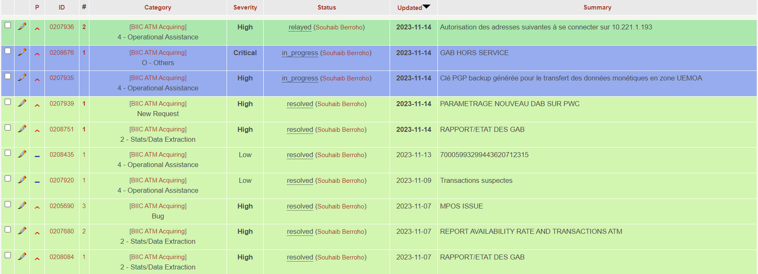
Ihelp Tickets

Slide 18
Upcoming Projects / Change Requests
VISA ATM Acquiring Project.
Integration with GTP Switch.
Routing of GTP Prepaid Cards Transactions through ICPS.
Loading of GTP Incoming Files (BASE II, LIS Incoming) on PowerCard.
Generation of Accounting File for BIIC.
GIM Pure Card Issuing Project.
VISA Debit Business Issuing Project.
Implementation of Batch for Fichier-Compte Client.

Slide 19
Contact Details
Name | Title | Phone Number | Email | Comments
Joel AFFOYON | DGA | +229 21 31 22 00 (fix) | joel.affoyon@biic-bank.com | Escalation (second)
Gildas | Directeur de la banque digitale, de la communication et du marketing | +229 21 31 22 00 (fix) +229 45 45 22 22 (mobile) | gildas.ayikpe@biic-bank.com | Escalation (first)
Elvice TOGBE |  |  | elvice.togbe@biic-bank.com | Reports to Joel A. Main Responsibility – ATMs
Monel ADETONAH |  |  | monel.adetonah@biic-bank.com | Reports to Elvice T. Main Responsibility – ATMs
Patrick AKLAMAVO | Responsible Service Reseau et Infrastructures | +229 21 31 22 00 (fix) +229 97 60 04 80 (mobile) | patrick.aklamavo@biic-bank.com | Main Responsibility – Network / SBIN Relationship

Slide 20
Contact Details
Name | Title | Phone Number | Email | Comments
Charbel GNAMBLOHOU | Responsible Service Support Digital | +229 21 31 22 00 (fix) | charbel.gnamblohou@biic-bank.com | Main Responsibility – Issuing Issues Support
Ami TCHAMBA | Responsible Service Développement et Base de données | +229 21 31 22 00 (fix) +229 94 93 67 53 (mobile) | ami.tchamba@biic-bank.com | Main Responsibility – Amplitude Issues / Pre-approved card files
Raoul TOGBE | Charge du reporting | +229 21 31 22 00 (fix) +229 97 27 84 74 (mobile) | raoul.togbe@biic-bank.com | Main Responsibility – Issuing Issues Support
Georges ATAKOUY |  | +229 21 31 22 00 (fix) | georges.atakouy@biic-bank.com | Main Responsibility Pre-approved card files

Slide 21
Thank you

